Slide 1
Seams in Compiler
Software Testing
Instructor: Dr. Sharbaf
Alireza Dastmalchi Saei

Slide 2
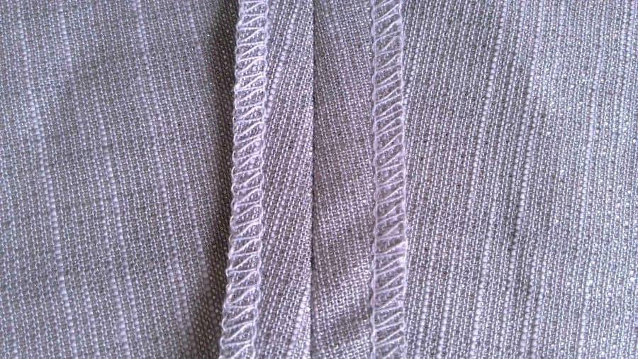
What are Seams?
1. A line where two piece of fabrics are stitched together.
2. A seam in software as a place where two parts of the code meet and where something else can be injected.
2
of 10

Slide 3
Seam Enabling Point
When you have a Seam:
A place in code where the behavior can change.
We can’t go to that place and change the code to test it.
Every seam has an enabling point, a place where you can make the decision to use one behavior or another.
3
of 10

Slide 4
Types of Seams
Pre-Processing Seam
Preprocessor gives us more seams
Link Seam
Object Seam
4
of 10

Slide 5
Pre-Processing Seam
C and C++ provides with preprocessing tool.
A macro preprocessor runs before the compiler
Use the preprocessing seams to replace calls to another independent piece of code.
5
of 10
Pre-Processing Seam
Link Seam
Object Seam

Slide 6
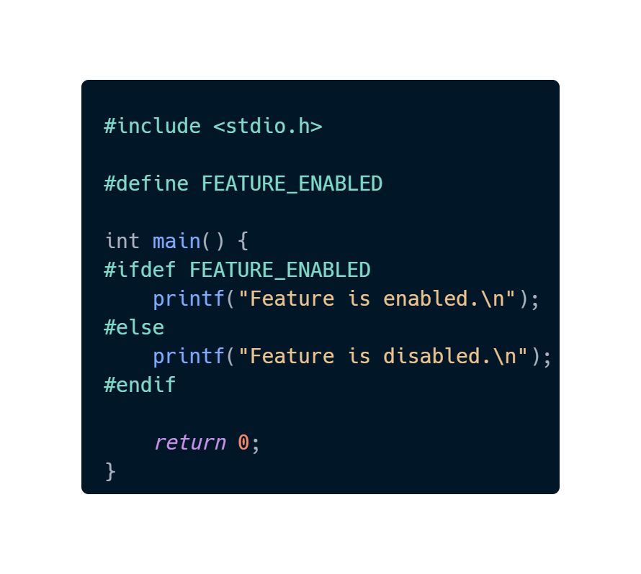
Conditional Compilation
Conditional Compilation Directives:
#ifdef
#ifndef
#if
#endif
Select which section of codes are included in the final compiled program.
6
of 10
Pre-Processing Seam
Link Seam
Object Seam

Slide 7
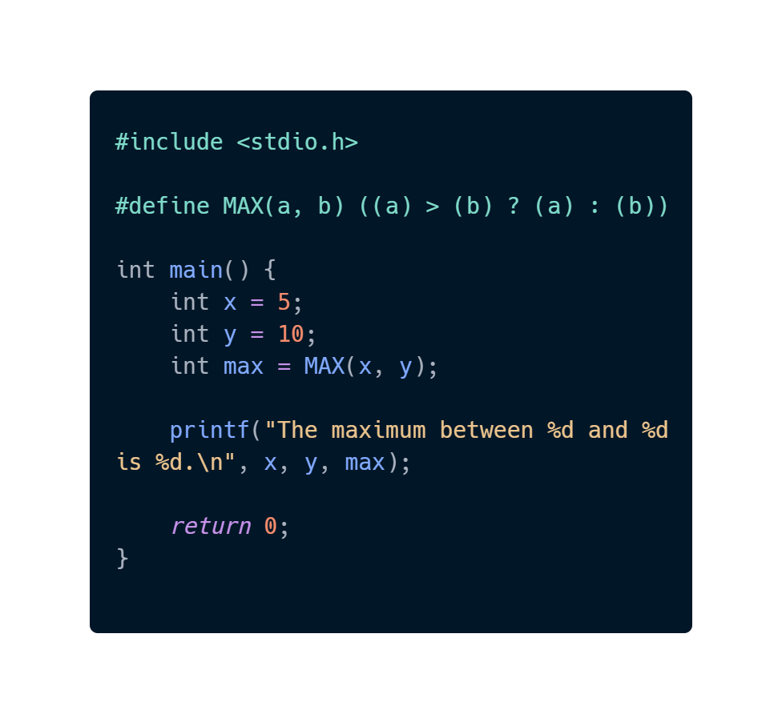
Macro Replacement
Macros can be used for code replacement during the pre-processing phase.
Whenever the “MAX” is encountered in the code, it gets replaced by corresponding macro expansion.
7
of 10
Pre-Processing Seam
Link Seam
Object Seam

Slide 8
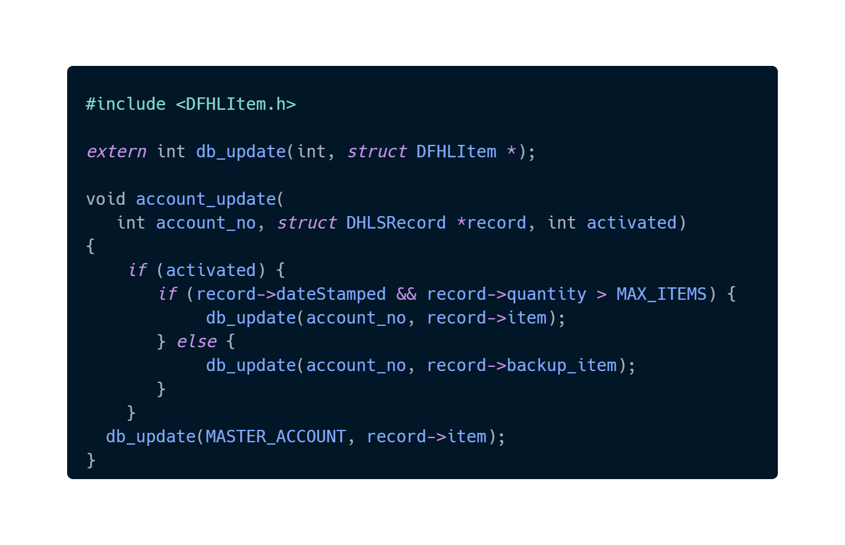
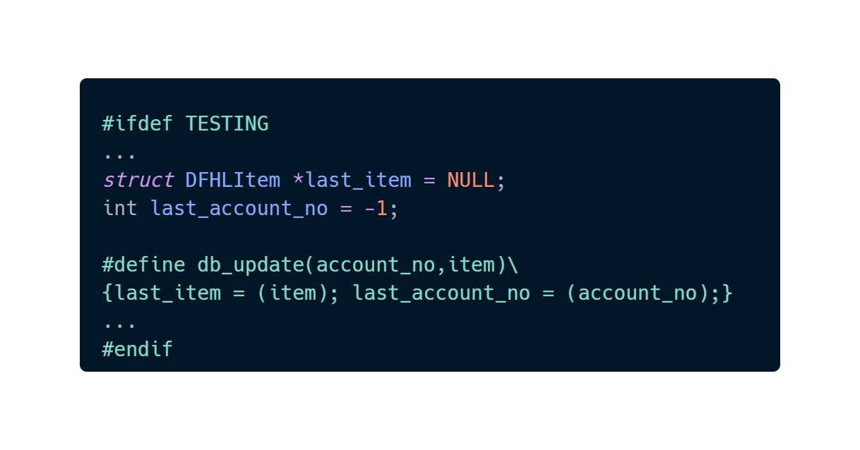
Macro Creation
8
of 10
Pre-Processing Seam
Link Seam
Object Seam

Slide 9
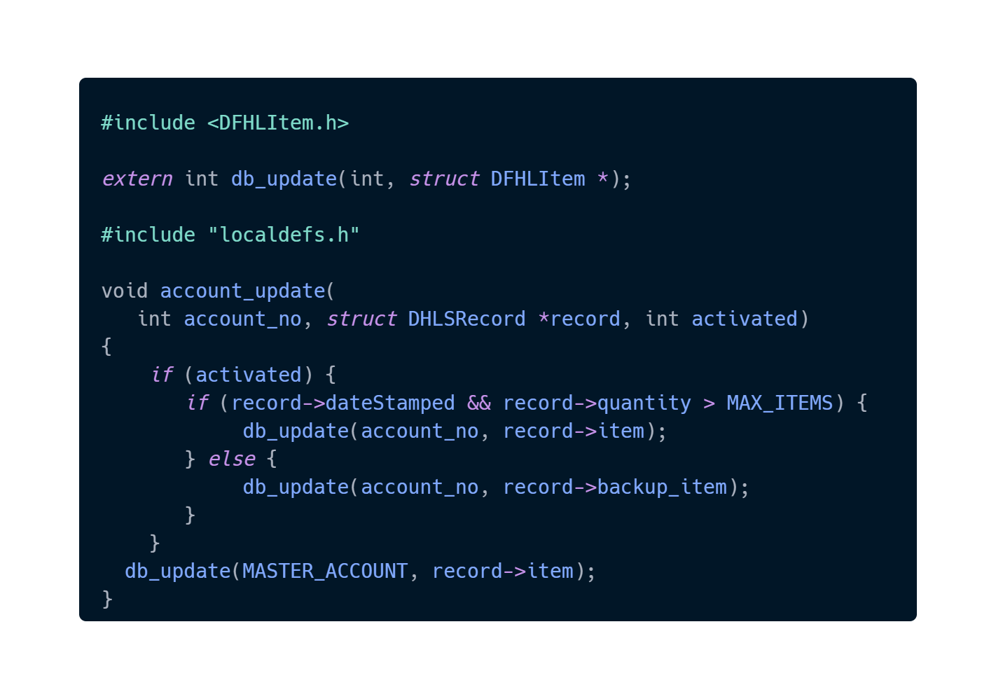
Macro Creation
9
of 10
Pre-Processing Seam
Link Seam
Object Seam

Slide 10
The End
Thanks for your attention!

